Slide 1
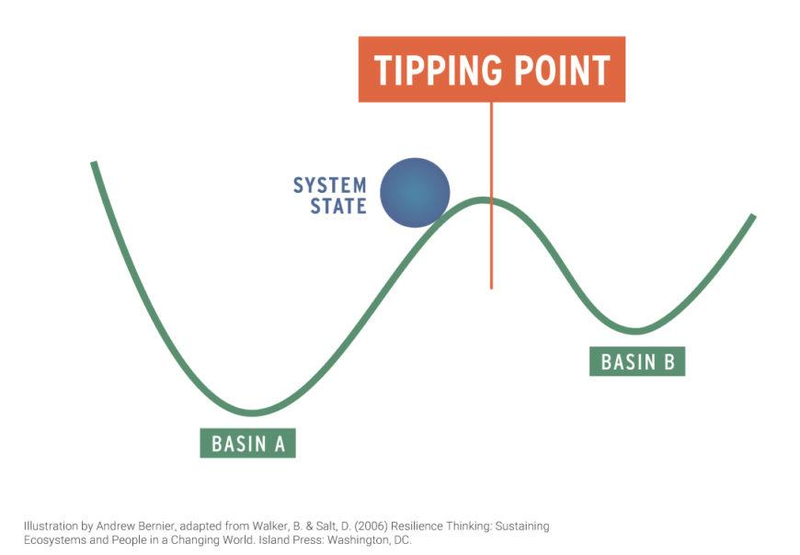

Positive Tipping Points
The point at which a series of small changes or incidents becomes significant enough to cause a larger, more important change
Oxford English Dictionary

Slide 2
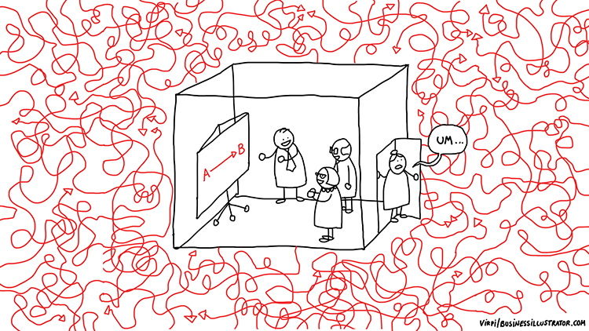
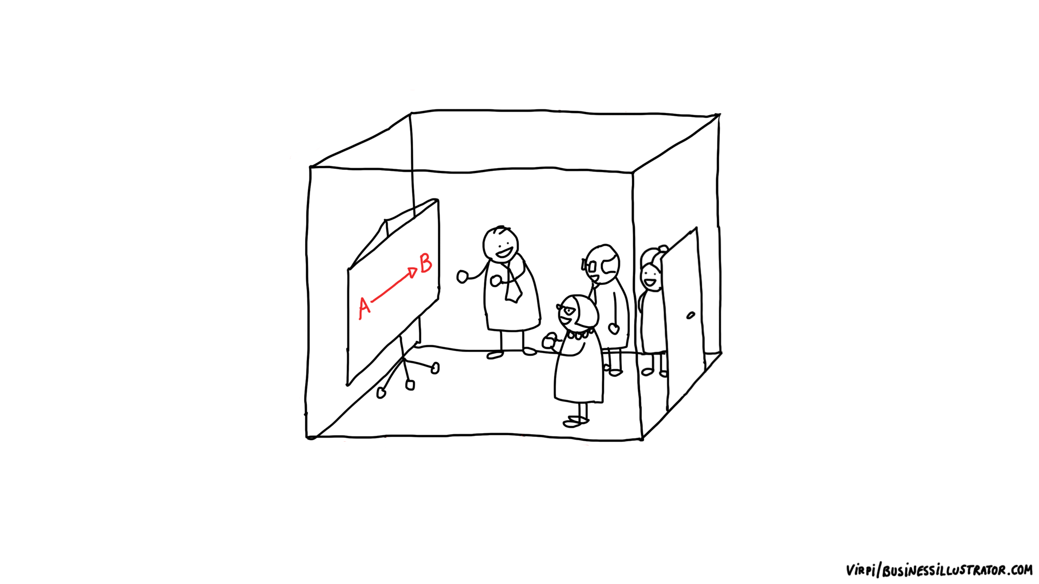
Positive Tipping Points
Unintended consequences
Overwhelm
Inefficiency
What they are
Why they are useful
What to do with them
The point at which a series of small changes or incidents becomes significant enough to cause a larger, more important change
Oxford English Dictionary

Slide 3
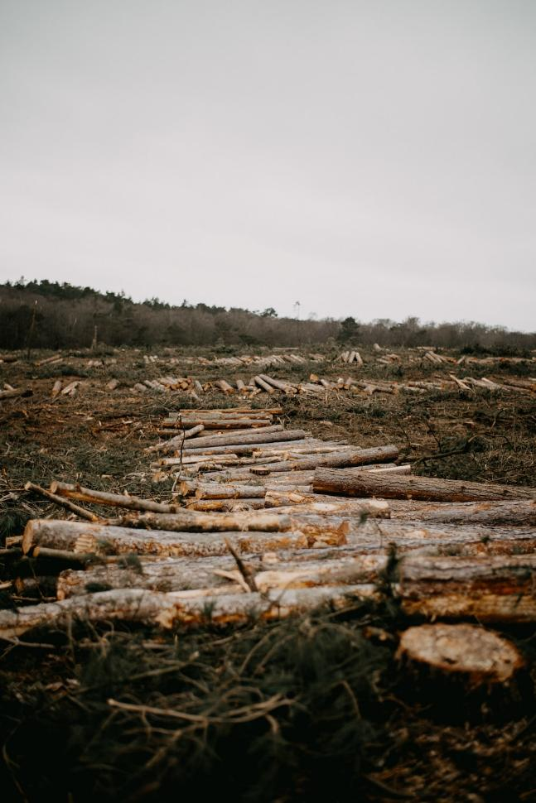
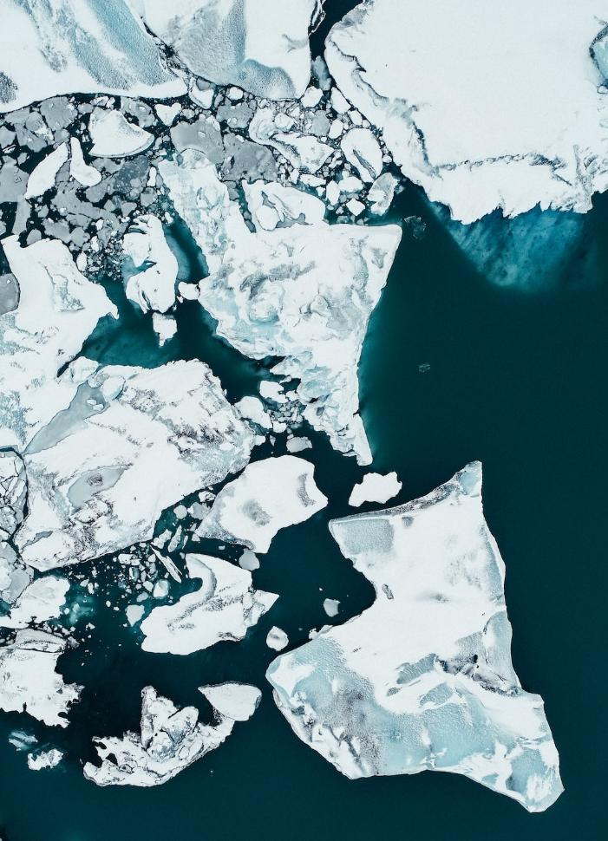
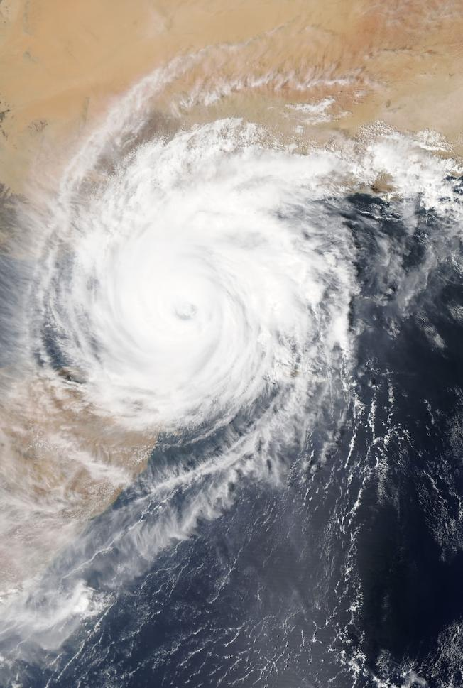

Slide 4
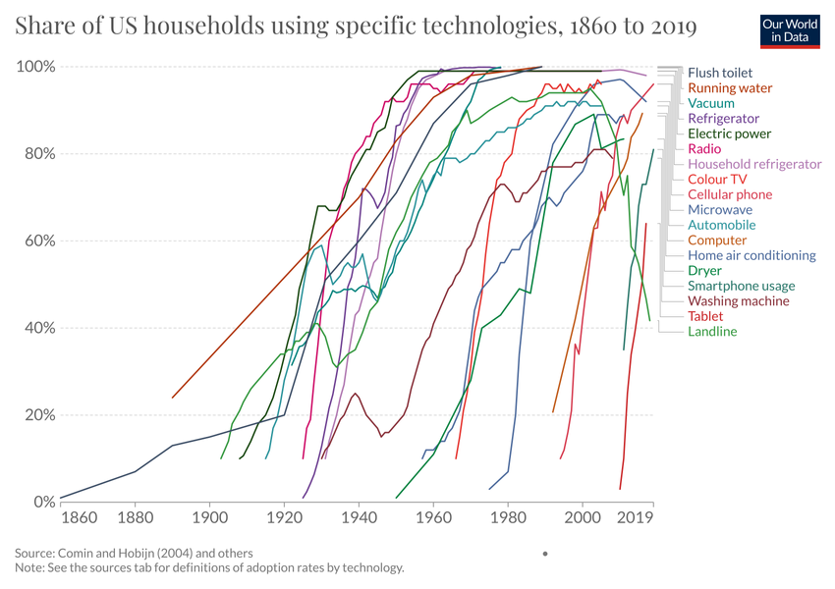

Slide 5
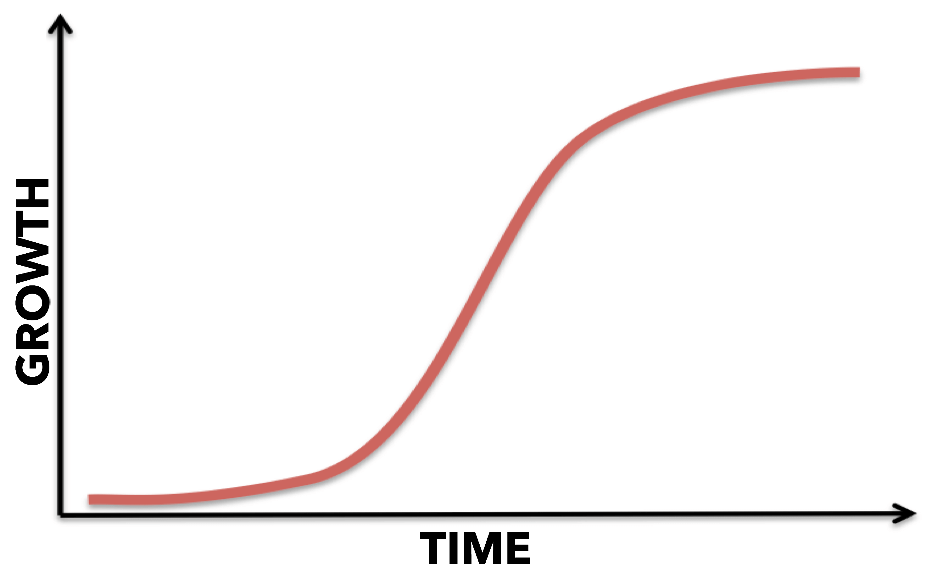
Net-zero
Plant-based diets
If this is resourced and joined up adaptation action, what is this?

Slide 6
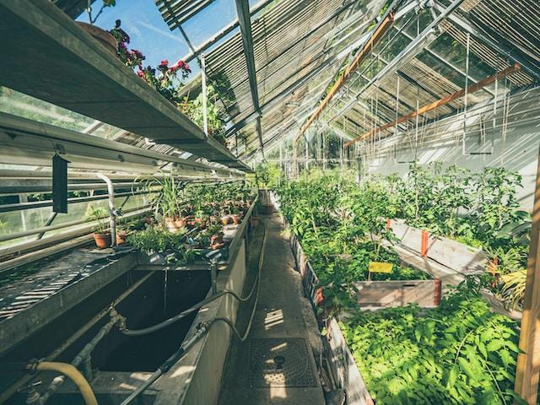



Photo by Alex Perez on Unsplash
Photo by neil macc on Unsplash

Slide 7
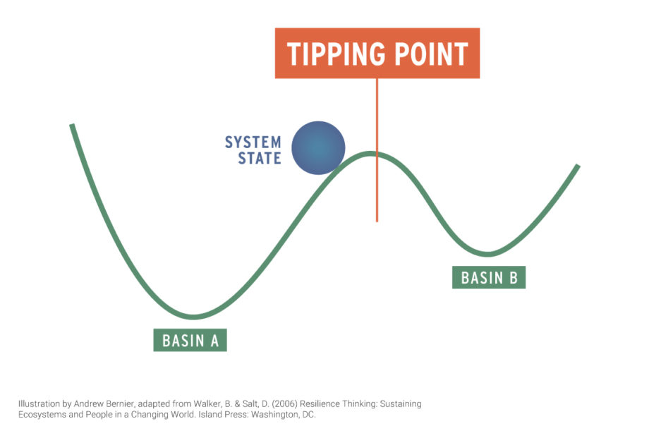
RESISTANCE
MOMENTUM

Slide 8


Photo by Wolfgang Hasselmann on Unsplash
Photo by Maud Correa on Unsplash

Slide 9
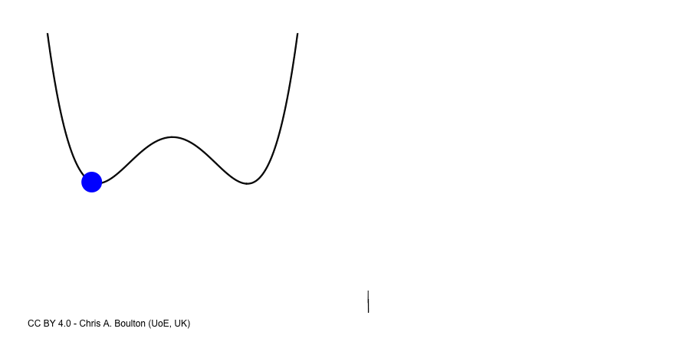
Passing a tipping point

Slide 10
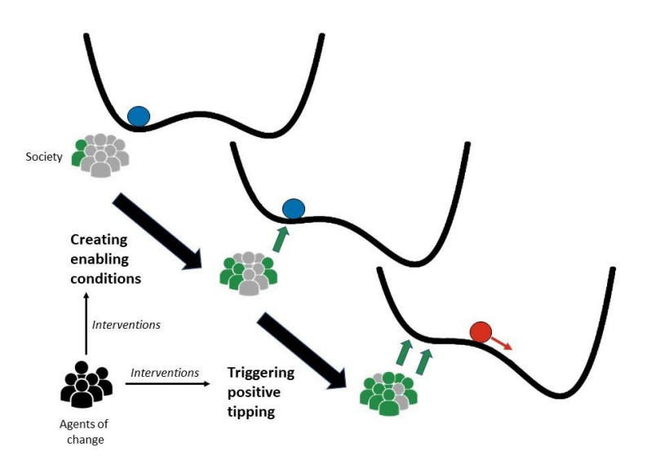
Create the conditions for change
Find reinforcing feedbacks
Trigger the change

Slide 11
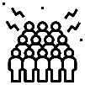















Create the conditions for change
Find the feedback loops
Trigger the change
Number of people
Access to information
Affordability
Quality
Desirability
Accessibility
Critical mass
Economies of scale
Learning by doing
Co-ordination
Social networks
Innovation
New policy
Behaviour change
Investment
New information

Slide 12
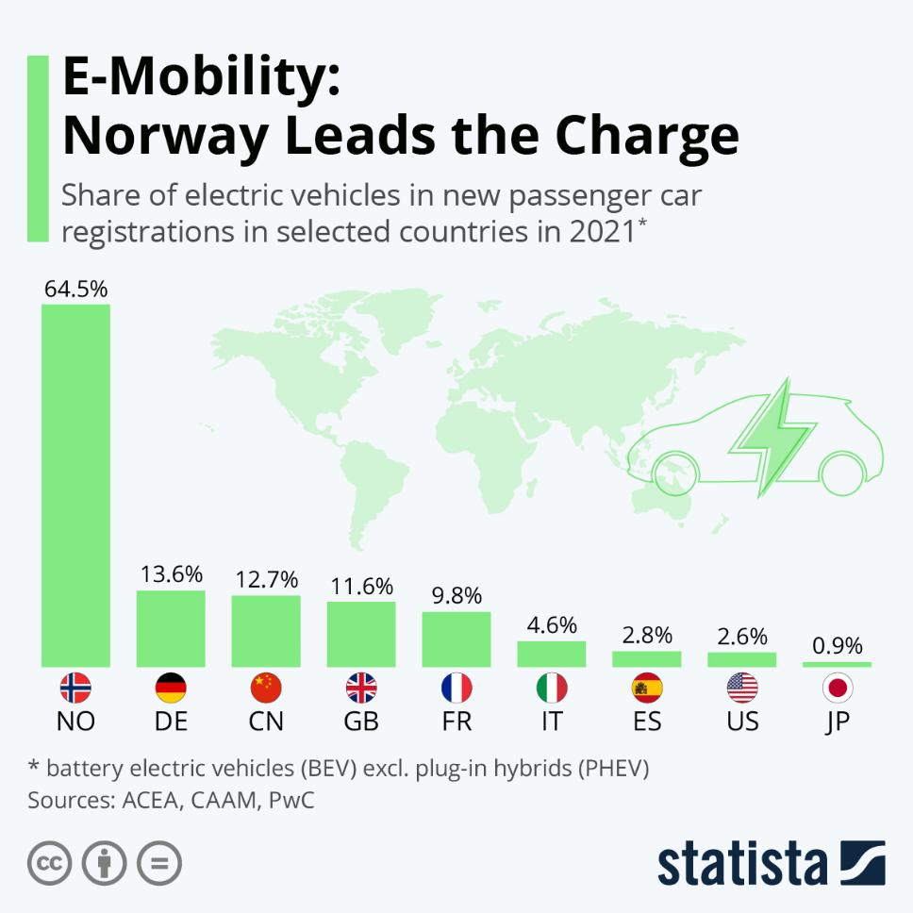
Price goes down
Quality goes up
Desirability goes up
Accessibility goes up
Cost of alternative goes up

Slide 13
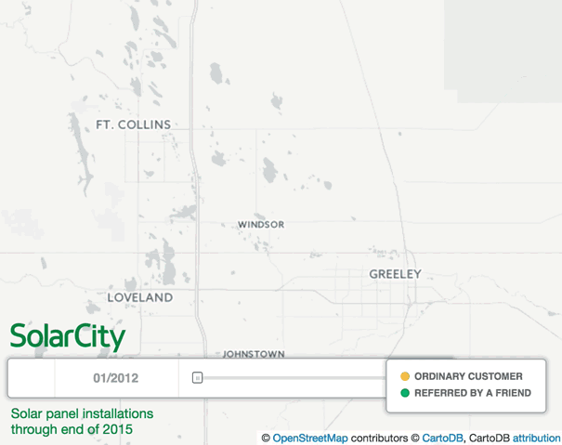
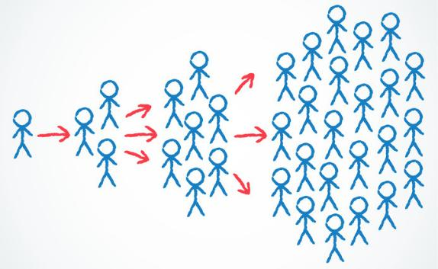

Social contagion
Notes:
2 mins on this (?)

Slide 14
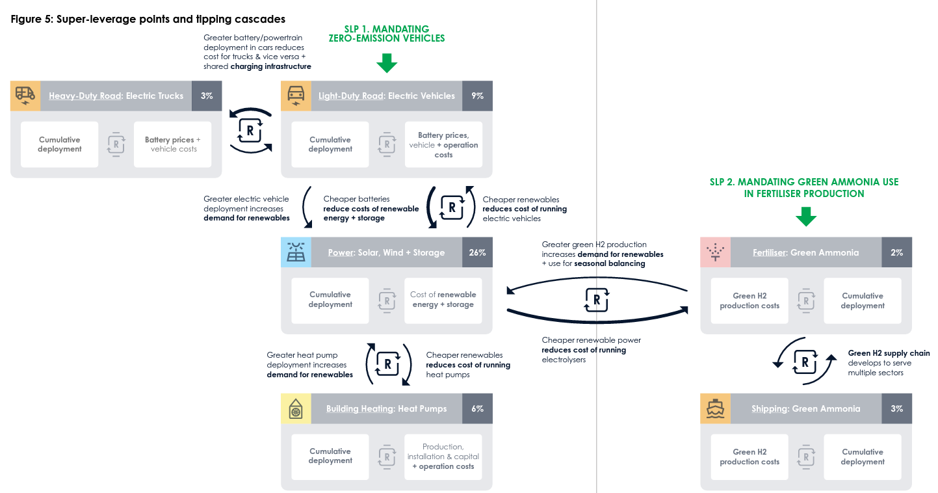
Source: The Breakthrough Effect, Systemiq

Slide 15

Local knowledge
Communication channels
Roles and processes
Legitimacy
“Mutual aid offered by group-based models and social movement networks provides routes to community resilience that support community-led responses to climate change focused on collective advocacy and care.”
Elise Harrington and Aileen Cole
Typologies of Mutual Aid in Climate Resilience: Variation in Reciprocity, Solidarity, Self-Determination, and Resistance – June 2022

Slide 16
Early warning indicators
Existing system/regime losing stability
Alternative new states
Potentially co-opted or otherwise undesirable
E
C
D

Slide 17
Create the conditions for change
Find reinforcing feedbacks
Trigger the change

